Slide 1
Decision analysis
Cost-benefit analysis
Efficient flow pollution
Efficient stock pollution
Alternatives
Applications
How to apply cost-benefit analysis
The London Super Sewer

Slide 2
0 Introduction
1 Social choice
2 Externalities and public goods
3 Decision analysis
4 Valuation: Aims and purpose
5 Valuation: Revealed preferences
6 Valuation: Stated preferences
7 Direct regulation
8 Market-based instruments
9 Complications with instruments
10 Growth and the environment
11 Green accounting

Slide 3
Decision analysis
Cost-benefit analysis
Efficient flow pollution
Efficient stock pollution
Alternatives
Applications
How to apply cost-benefit analysis
The London Super Sewer

Slide 4
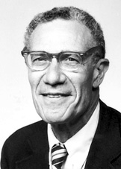
[E]conomists have the reputation of being
unimaginative bean-counters, doggedly
claiming to quantify the unquantifiable [...]
and personifying Oscar Wilde’s definition
of a cynic as someone who knows the price
of everything and the value of nothing. [...] It is
true that they would give a lot for a rough
quantitative answer; but that only reflects the
fact that any policy can be pushed harder or less
hard, further or less far, and that a useful
evaluation has to suggest how hard and how far.
The beans have to be counted, if only
approximately: those gentle souls who merely ooh
and ah over them are arguably part of the
problem, not part of the solution.
Robert M. Solow

Slide 5
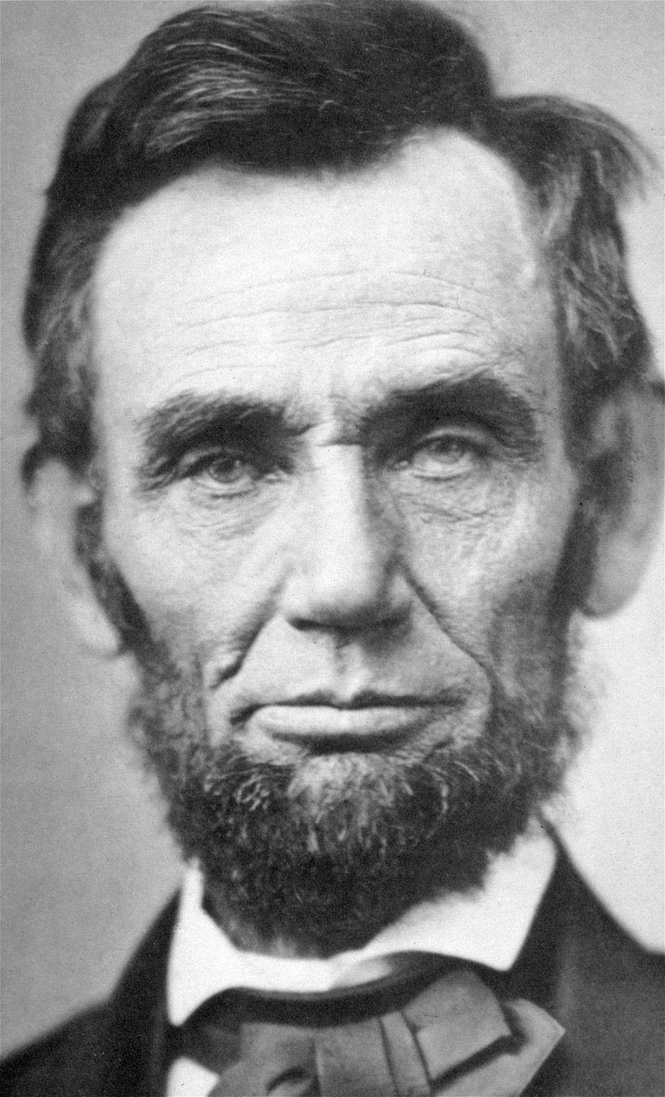
The true rule in determining to embrace or reject anything is not whether it have any evil in it; but whether it have more of evil than of good. Abraham Lincoln
Notes:
A bit of homespun wisdom from Abraham Lincoln.
Can think of CBA as a way to systematise the way we make this determination.
Do gains exceed losses?

Slide 6
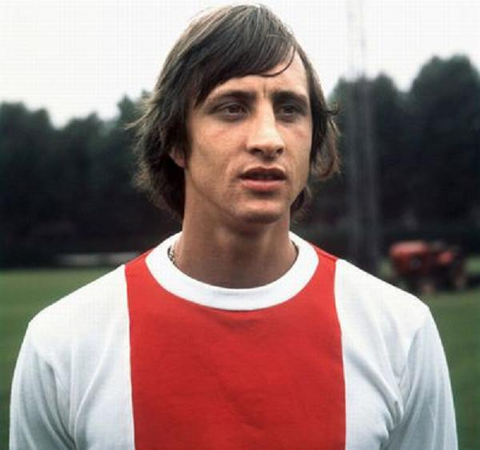
Every upside has its downside
Johan Cruyff

Slide 7
Pollution
Pollution is an externality, that is, the unintended consequence of one’s production or consumption on somebody else’s production or consumption
Pollution depends on
Environmental transport, transformation and assimilation
Existing loads
Pollution can be
Flow pollution
Stock pollution
Mixed
Sulphur in coal becomes
sulphur dioxide on combustion,
sulphur trioxide in the atmosphere, and
sulphuric acid in contact with water

Slide 8
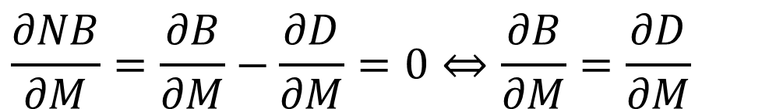
Efficient Flow Pollution
Damages of pollution D=D(M)
Benefits of polluting activity B=B(M)
Net benefits NB=B(M)-D(M)
Efficient pollution Max NB
$$\frac{∂NB}{∂M}=\frac{∂B}{∂M}−\frac{∂D}{∂M}=0⇔\frac{∂B}{∂M}=\frac{∂D}{∂M}$$

Slide 15
Welfare analysis
Area B Optimal level of environmental damage
Area A+B Optimal level of net private benefits of the polluter
Area A Optimal level of net social benefits
Area C+D Level of non-optimal externality that needs regulation
Area C Level of net private benefits that are unwarranted
Q* Optimal level of economic activity
Q’ Level of economic activity that maximises private benefits

Slide 16

Efficient Flow Pollution (2)
Optimal pollution is greater than zero

Slide 17
Efficient Flow Pollution (2)
Optimal pollution is greater than zero
The laws of thermodynamics imply that zero pollution implies zero activity, unless there are thresholds (e.g., assimilative capacity)

Slide 19
Efficient Flow Pollution (2)
Optimal pollution is greater than zero
The laws of thermodynamics imply that zero pollution implies zero activity, unless there are thresholds (e.g., assimilative capacity)
Optimal pollution is greater than the assimilative capacity
Pollution greater than the optimal pollution arises from discrepencies between social and private welfare

Slide 20
Decision analysis
Cost-benefit analysis
Efficient flow pollution
Efficient stock pollution
Alternatives
Applications
How to apply cost-benefit analysis
The London Super Sewer

Slide 21


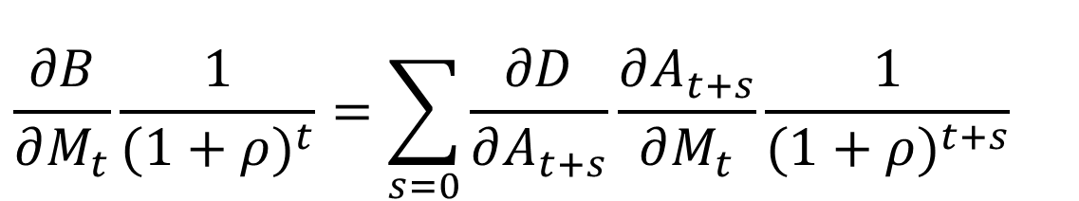
Efficient Stock Pollution
Damages of pollution D=D(A)
Benefits of polluting activity B=B(M)
Stock:
Net current benefits NB=B(M)-D(A)
Efficient pollution Max NPVNB
$$A_{t}=(1−δ)A_{t−1}+M_{t−1}$$
$$\text{NPV}NB=\sum{\frac{B(M_{t})−D(A_{t})}{(1+ρ)^{t}}}$$
$$\frac{∂B}{∂M_{t}}\frac{1}{(1+ρ)^{t}}=\sum_{s=0}{\frac{∂D}{∂A_{t+s}}\frac{∂A_{t+s}}{∂M_{t}}\frac{1}{(1+ρ)^{t+s}}}$$

Slide 22
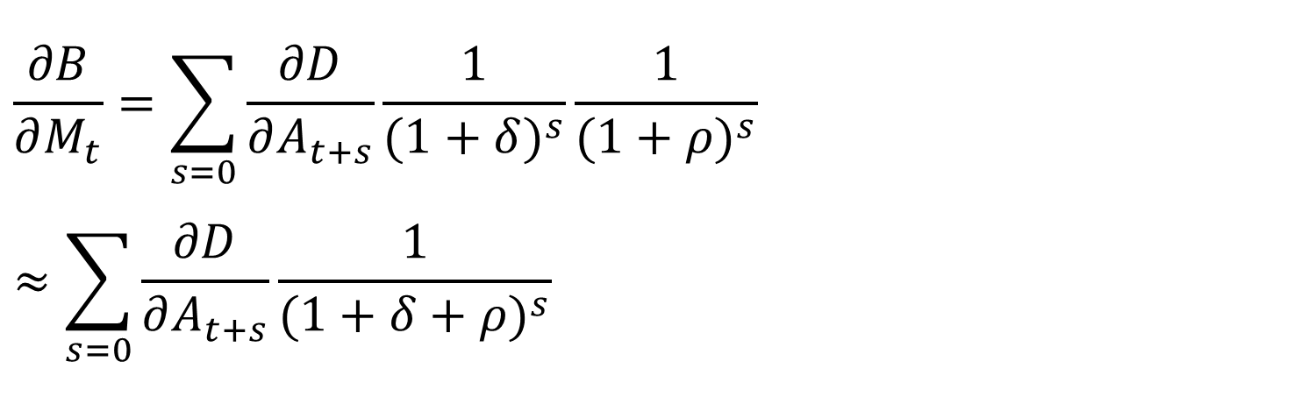
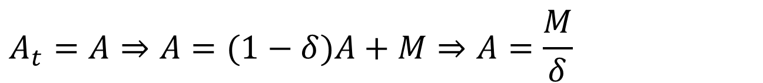
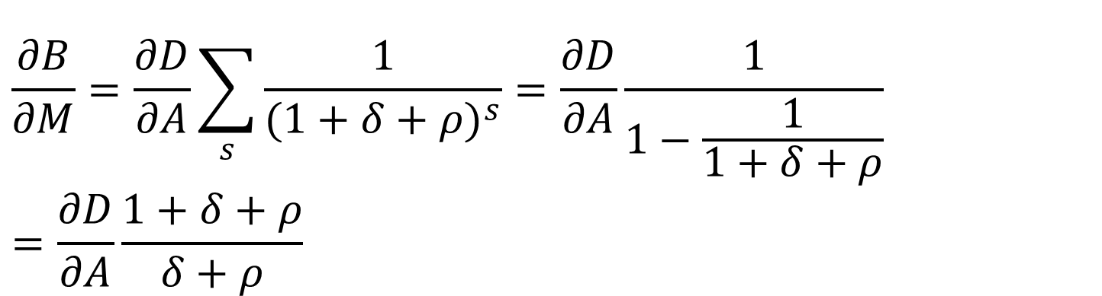
Steady State
$$\frac{∂B}{∂M_{t}}=\sum_{s=0}{\frac{∂D}{∂A_{t+s}}\frac{1}{(1+δ)^{s}}\frac{1}{(1+ρ)^{s}}}≈\sum_{s=0}{\frac{∂D}{∂A_{t+s}}\frac{1}{(1+δ+ρ)^{s}}}$$
Steady state
$$A_{t}=A⇒A=(1−δ)A+M⇒A=\frac{M}{δ}$$
$$\frac{∂B}{∂M}=\frac{∂D}{∂A}\sum_{s}{\frac{1}{(1+δ+ρ)^{s}}}=\frac{∂D}{∂A}\frac{1}{1−\frac{1}{1+δ+ρ}}=\frac{∂D}{∂A}\frac{1+δ+ρ}{δ+ρ}$$

Slide 23
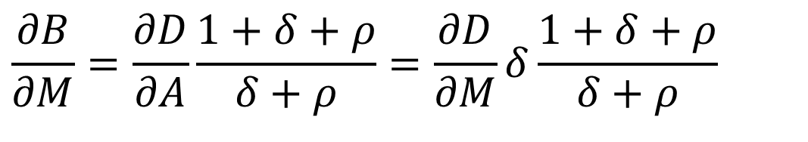
Steady State (2)
$$\frac{∂B}{∂M}=\frac{∂D}{∂A}\frac{1+δ+ρ}{δ+ρ}=\frac{∂D}{∂M}δ\frac{1+δ+ρ}{δ+ρ}$$
Marginal benefit of the polluting activity equals the net present value of marginal pollution damages
Benefits of pollution are current only (by assumption)
Damages of pollution are a perpetual annuity
The decay rate (δ) acts as a discount rate

Slide 24
Decision analysis
Cost-benefit analysis
Efficient flow pollution
Efficient stock pollution
Alternatives
Applications
How to apply cost-benefit analysis
The London Super Sewer

Slide 25
Alternative Standards
Optimal pollution is but one way of setting standards and not the most popular
The main difficulty lies in estimating the disutility of pollution

Slide 26
Alternative Standards
Optimal pollution is but one way of setting standards and not the most popular
Multicriteria analysis

Slide 27
Multicriteria Analysis
Many variants – here is one
Option A is dominated, worse on both scores
Difference between B and C is 150,000 badgers, 15 infected herds
If 1 herd is worth more than 10,000 badgers, C is preferred to B
Break-even point: 1 cow = 50 badgers
Option | # badgers | # infected herds
A | 250,000 | 25
B | 400,000 | 22
C | 250,000 | 7

Slide 28
Multicriteria Analysis
Many variants – here is another
Option A is dominated, worse on both scores
Let a group of experts vote on B and C
Option | # badgers | # infected herds
A | 250,000 | 25
B | 400,000 | 22
C | 250,000 | 7

Slide 29
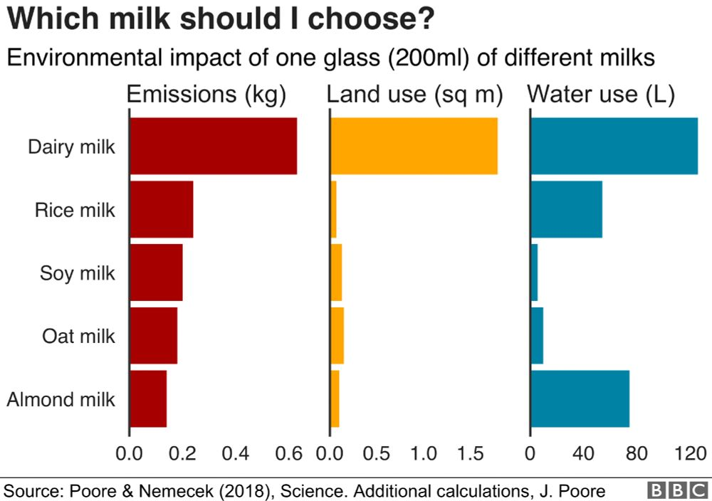
Multicriteria Analysis
Voting rules become complicated with many options and many criteria

Slide 30
Alternative Standards
Optimal pollution is but one way of setting standards and not the most popular
Multicriteria analysis
Alternatives
Safe minimum standards
Citizen juries, referendums
Best available technology
Precautionary principle
Arbitrary standards
Cost-effectiveness analysis

Slide 31
Decision analysis
Cost-benefit analysis
Efficient flow pollution
Efficient stock pollution
Alternatives
Applications
How to apply cost-benefit analysis
The London Super Sewer

Slide 32
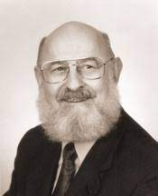
Applied Cost-Benefit Analysis
Social CBA: analytical tool to inform decisions about public expenditure over time
It requires systematic counting and valuation of all relevant costs and benefits to society as a whole
Benefits = anything that increases human welfare
Costs = anything that decreases human welfare
It recommends policies where
Benefits outweigh costs — B > C, B / C > 1 (single project)
Net benefits (benefits – costs) are maximised
Notes:
Benefits = relevant area under demand curve (ignoring any price line — total WTP)
Costs = area under marginal cost curve
Already saw a bit of this in topic 2 problem set — benefits of preserving miles of river.

Slide 33

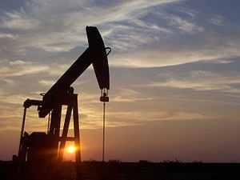
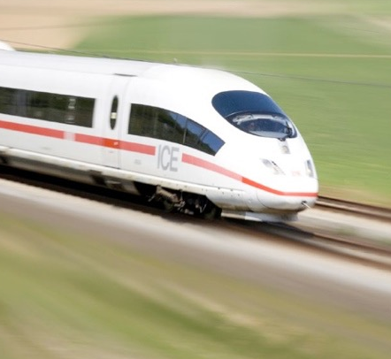

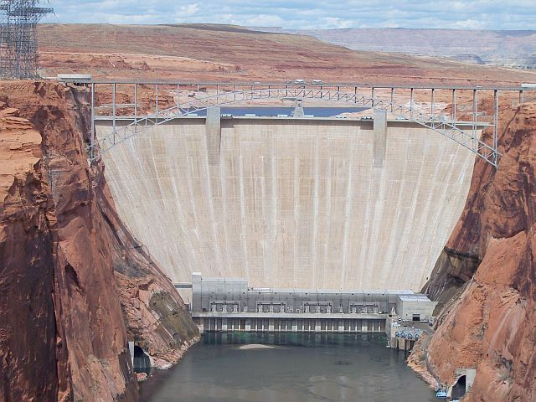

Uses of CBA
Overall environmental policy
Appraisal of specific projects
Environmental management
Ex-ante or ex-post
Notes:
CBA may be applied at various scales.
We can apply CBA:
(1) to matters of general environmental policy. Who can drill where for oil? (Fracking?) What areas of land should be protected from development? Should we ban the pesticides that are killing bees? What steps should we be taking to mitigate climate change? And so on. An essential input to evidence-based policy-making.
(2) to the appraisal of specific projects. Should I cut down this tropical rainforest? Should I build a hydroelectric dam such as the Severn Barrage (or like the example at the end of your first problem set)? Should I build HS2, a high speed rail link between London and Birmingham? New runway at Heathrow or Gatwick or neither? Bid to host the Olympics?
In these cases especially it’s critical to consider the counterfactual. What are we comparing to? E.g. cutting down a forest => not cutting down a forest, but Severn Barrage CBA => gas or nuclear power plant to meet electricity demand instead. Etc.
(3) to the management of particular systems or environments. For example:
* Hydroelectric dams. Size and timing of releases affects: value of electricity generated; recreational options up and downstream; habitat availability for endangered species.
* Privatised water utilities (dozens of private monopolies -- _duh_ -- but also a gravy train for environmental economics consultants!). What are people WTP for fish kills? Bathing quality? Water clarity, taste, etc.? (see this with our example later)
You can apply CBA ex ante or ex post — before or after a decision is made.
- Ex-post much easier, because you know what it cost and what the outcomes were.
- Less immediately useful, because you already did it. But scope to learn a lot for the future.
- Unfortunately it almost never happens, because politicians hate to be shown to have made the wrong decision.

Slide 34
Ex post
Of US environmental regulations from 1990 – 1995, ~50% fail cost-benefit test (Hahn 1996)
Few EU Directives pass cost-benefit test either (Pearce 2004)
However, there are (1) a variety of ways in which CBA may be systematically biased against pro-environmental policies and regulations (Graves 2012) and (2) other goals we might pursue beyond efficiency

Slide 35
What about equity?
Policymakers could address equity separately
e.g. compensation through tax system
potential v actual Pareto improvements
Given enough projects, differences might ‘come out in the wash’
Or they might not (cf. final week)
Use CBA as one input to a policy decision — not to provide the decision by itself
Notes:
The PPI criterion completely separates efficiency and equity.
So what about equity?
Well, …
However, given political difficulties of redistribution, compensation is probably rare in reality.
And on the second point, well, they might — but they might not. [click — Brexit]
Equity issues — i.e. the distribution of costs and benefits between different sections of society — are one of the main reasons why we should use CBA only as one input to the policymaking discussion — not as a replacement for it.

Slide 36
Ten stages of CBA
Rationale for intervention
Identify the portfolio of candidate projects and define a baseline or counterfactual: what will happen if none of these things do?
Decide whose benefits and costs count (standing, or accounting stance)
Identify all potential impacts, physical and biological
Predict scale of impacts over the life of the project
Monetize (attach money values to) all impacts
Discount to find present values
Aggregate: add up all the benefits and costs, calculate net benefits
Perform sensitivity analysis
Recommend the alternative with the largest net benefits
Notes:
… Baseline or counterfactual: could be status quo, do nothing (e.g. build dam — not build dam). But doing nothing may not be an option — e.g. alternative to building a nuclear power station might be building a lot of wind turbines, or a few gas power stations, or insulating everyone’s lofts. (Latter almost certainly much better).
…
6 - monetisation: crucial, next two lectures

Slide 37
Decision analysis
Cost-benefit analysis
Efficient flow pollution
Efficient stock pollution
Alternatives
Applications
How to apply cost-benefit analysis
The London Super Sewer

Slide 38
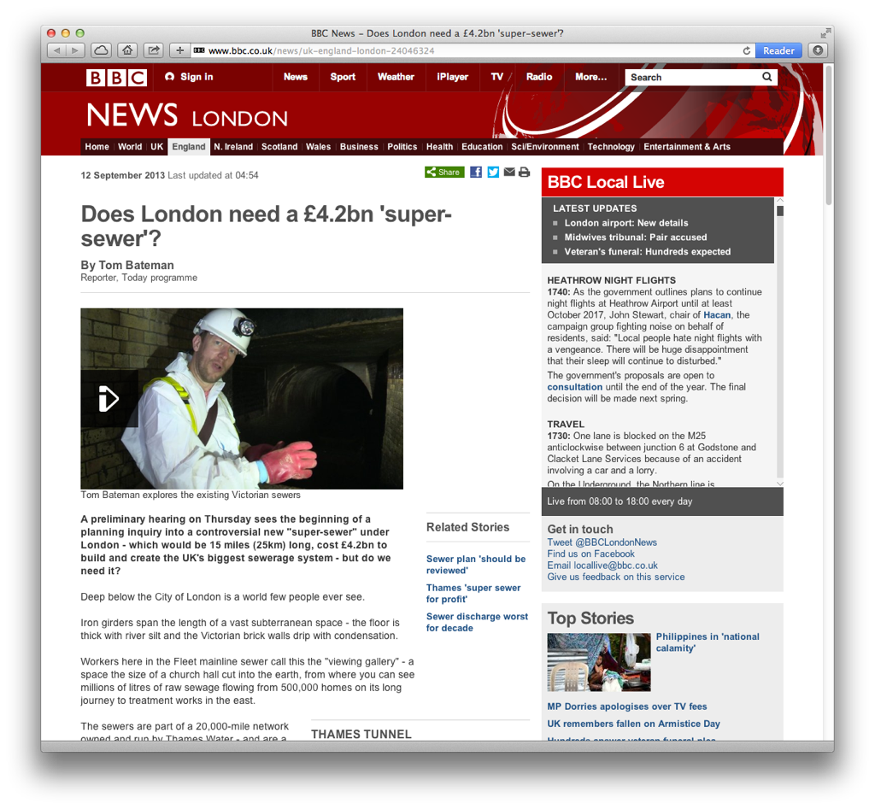
Case study: London’s super sewer
Notes:
So let’s follow a real valuation study …

Slide 39

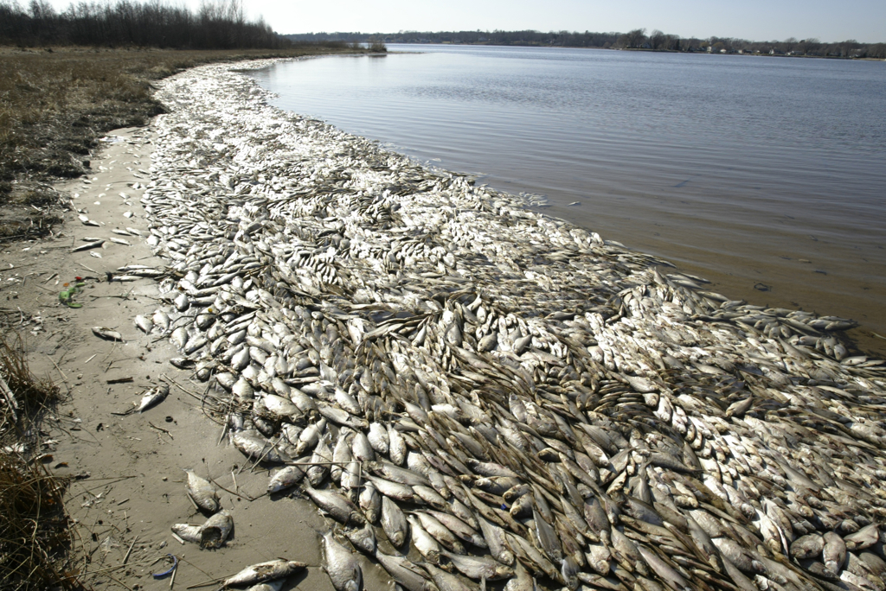
Step 1: rationale for intervention
London’s Victorian sewer system carries rainwater and human waste
Rain overloads treatment capacity, raw sewage discharged into Thames 60× a year
Non-market impacts
Visual appearance
Health risks (swimmers, rowers, …)
Fish are killed
Notes:
(David Walliams swam the Thames for Comic Relief in 2011 and ended up with vomiting and diarrhoea).
…
Step 1, rationale for intervention: there’s a problem. We’re discharging raw sewage into the Thames.
CBA asks: how big is the problem, in financial terms? Can we fix the problem for less than that? What’s the best option?

Slide 40
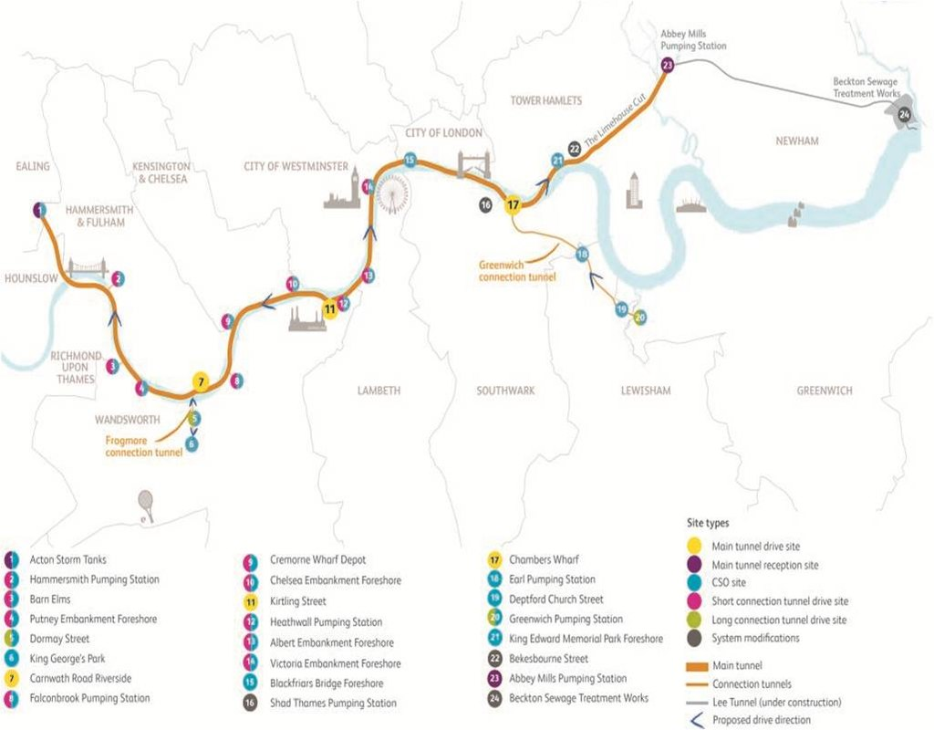

Slide 41
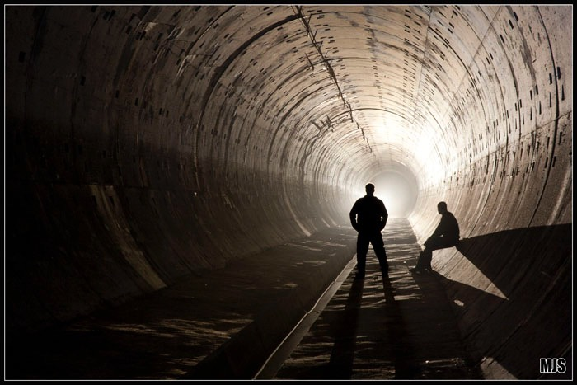
Notes:
V similar situation in Brighton until 1995: after heavy rain, raw sewage discharged into sea — until our own super sewer built all along the seafront underground.
“Southern Water has now built Europe's largest storm water storage tunnel, 3 miles, 20ft diameter, 100ft under the seafront … Where once the overflow outfall discharged directly into the sea alongside Palace Pier water now drops down 100 foot shaft into the new storage tunnel.”
Blue flag! Swim! (in summer)

Slide 42
Step 2: identify candidate projects
Various engineering solutions (×24)
New treatment plants
Upgrades to existing plants
Storage and transfer tunnels (the super sewer)
Define a baseline: what would happen otherwise?
In this case: the status quo
Do nothing new, keep operating bubbler and skimmer boats

Slide 43
Step 3: who has standing?
Whose benefits and costs should count?
Question of judgment
In a nation, commonly count only residents (unless you’re Theresa May or Keir Starmer)
Super sewer
Thames Water customers
5 million households in London + SE
They’ll be paying through water bills

Slide 44
Step 4: identify all potential impacts
 | Benefits | Costs
Market | Avoided cost of operating bubbler and skimmer boats | Capital expenditure Operating expenditure
Non-market | Improved visual amenity (less litter) Fewer health risk days Fewer fish kills | Noise and disruption during construction Energy-related pollution ...

Slide 45
Omissions
Air quality, odour, noise, vibration from construction works
Cultural heritage: archaeological remains
Ecological impacts other than dead fish
Hydrological impacts
…
Notes:
In practice, there are lots of impacts it’s impractical to forecast and/or monetise because of uncertainty or lack of available data. In case of super sewer …

Slide 46
Step 5: predict scale of impacts
Quantify all impacts for all candidate projects in every period over project lifetime
Extremely difficult! Long periods and complex systems
Super sewer: 50 years × 24 projects × 4 dimensions:
Capex + opex
Number of fish kills
Number of health risk days
Amount of sewage litter

Slide 47
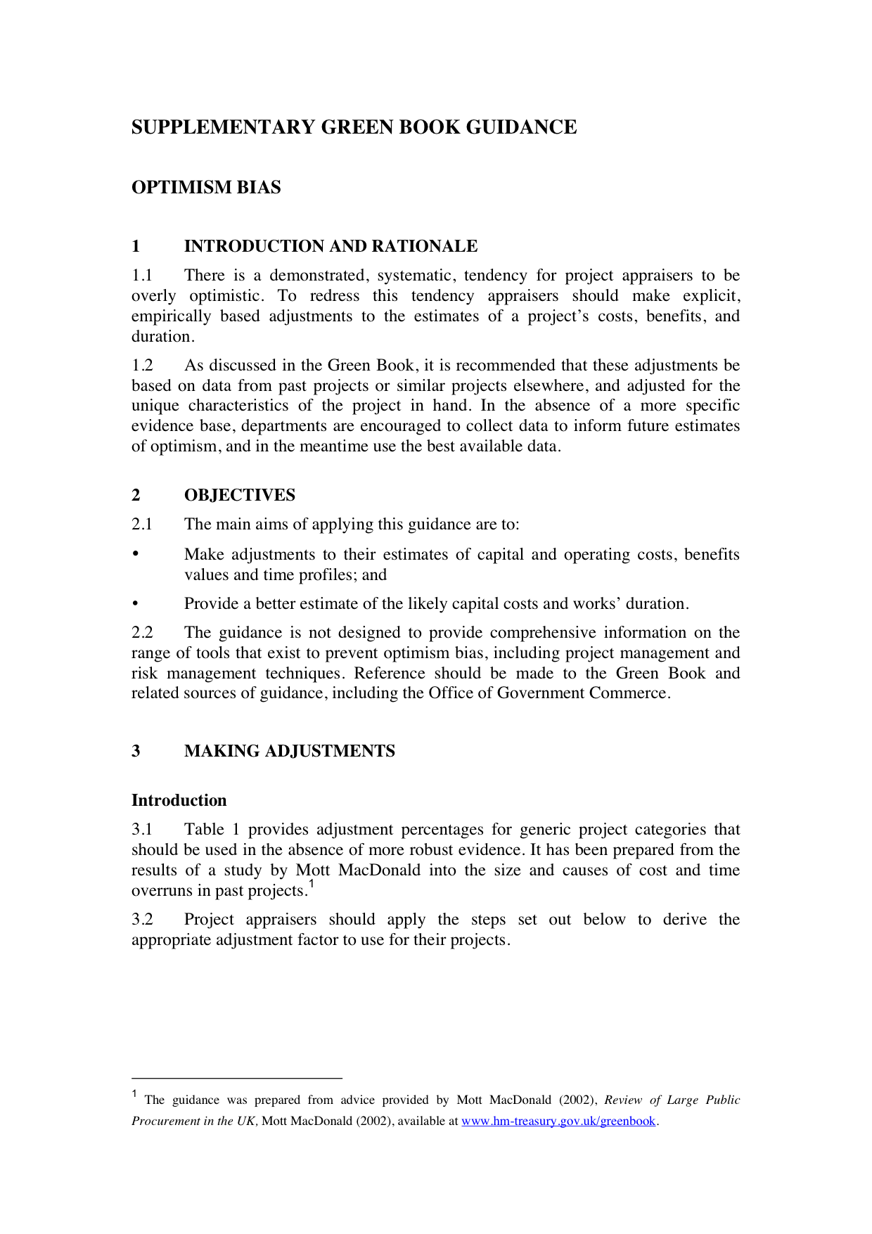
Notes:
When predicting, be wary of …
Optimism bias … underestimate capex and opex, understate timings, overstate benefits.

Slide 48
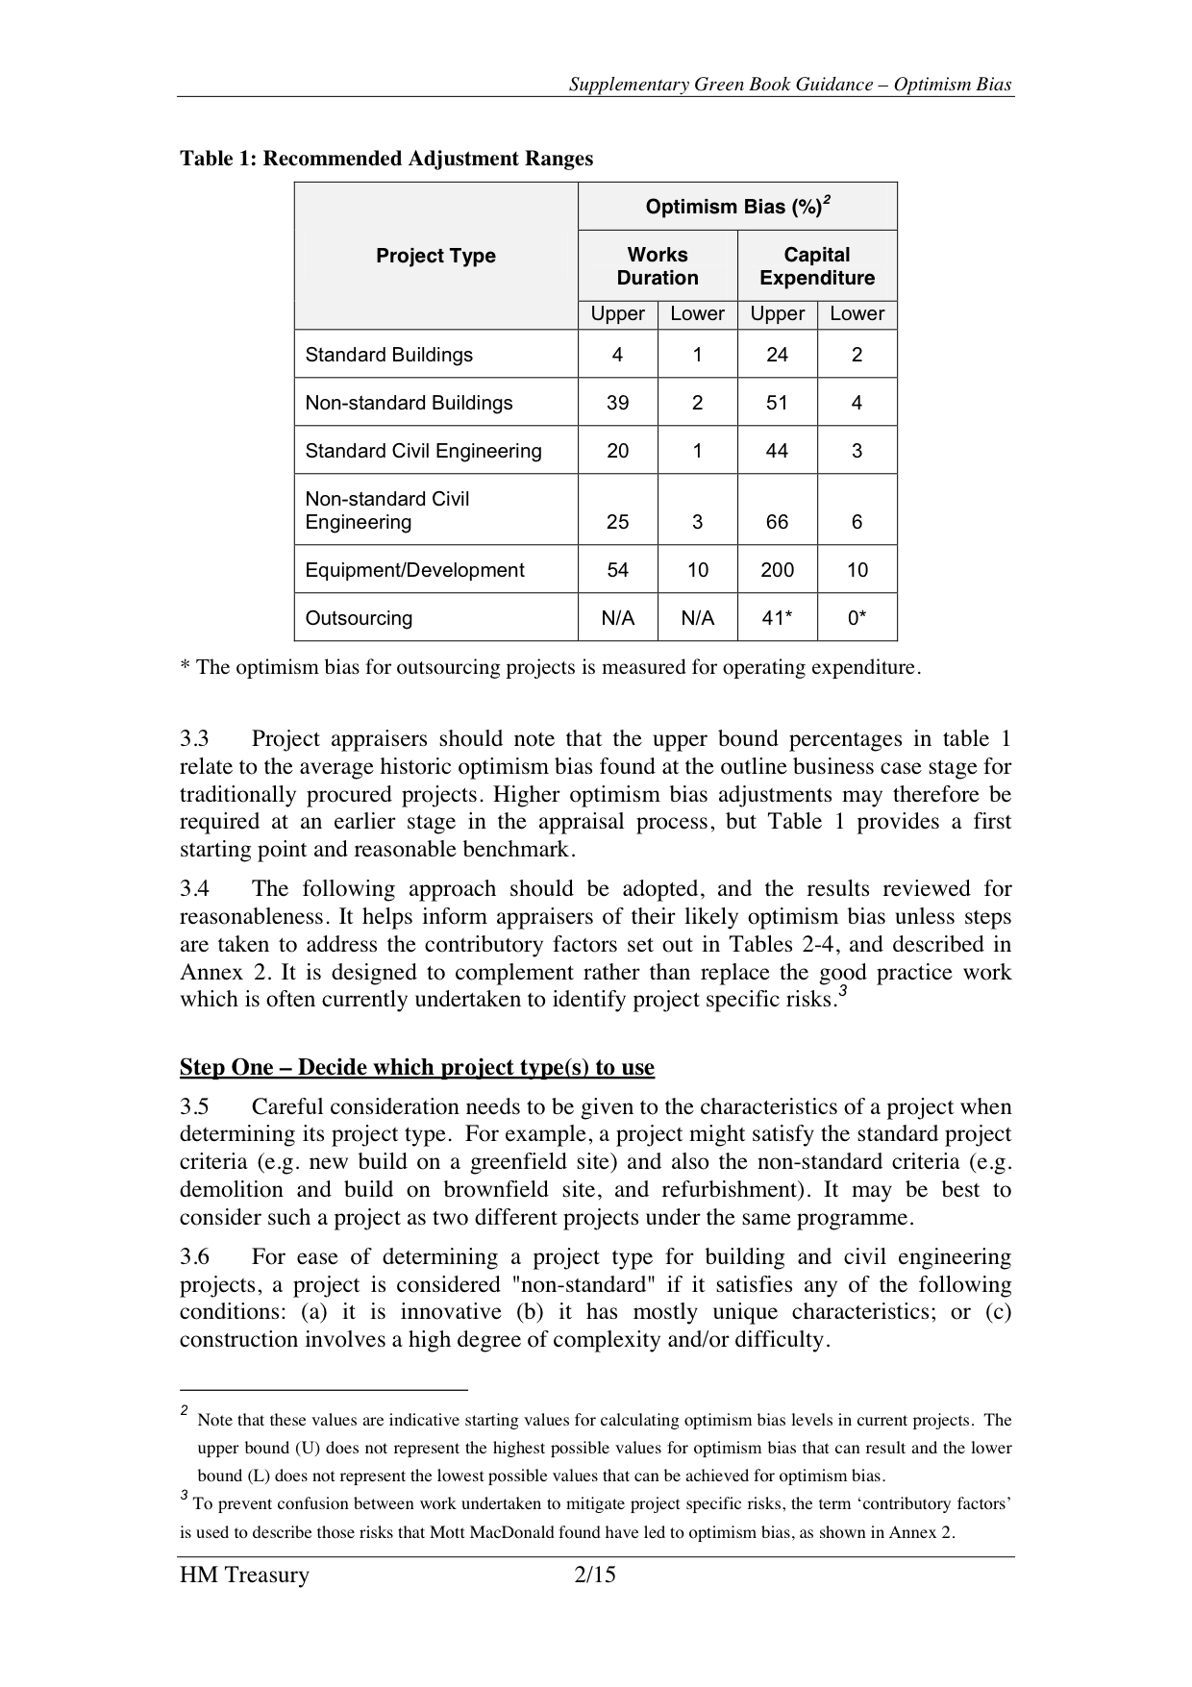
Notes:
Therefore it is usual to adjust predictions in a pessimistic direction.
E.g. expect capex on standard buildings construction to be up to 24% higher than original estimates.
For non-standard engineering, add two-thirds (Hinkley Point, anyone?).
And for procuring or developing equipment, double your best estimate!
(Anyone who watches Grand Designs on C4 will find that very familiar).

Slide 49
Step 6: monetize impacts
Valuation
Market prices
Adjusted market prices
Non-market valuation
Super sewer
Sewage litter: £1.82 per 1% of total litter
Health risk: £0.38 per day
Fish kills: £1.51 per event
Notes:
We will be thinking more about this in the next two lectures after this one.

Slide 50
Step 7: discount to find present values
Costs and benefits occur over time
So we can’t just add them up
Future benefits and costs are discounted at a rate r to obtain equivalent present values
PV(B) = B0 + B1/(1 + r)¹ + B2/(1 + r)² + … + Bt/(1 + r)^{t}
PV(C) = C0 + C1/(1 + r)¹ + C2/(1 + r)² + … + Ct/(1 + r)^{t}
NPV = PV(B) – PV(C)
Notes:
We talked about this last week and you all knew it already then!
The magic figure we are trying to reach is the NPV.

Slide 51
The importance of r
£100 invested for 100 years becomes
Conversely, PV(£1.4m in 100 years) at r = 10% is only £100 today
r = 2.1% | £799
r = 3.5% | £3,100
r = 7% | £87,000
r = 10% | £1,400,000
Notes:
And the same as with compounding, the changes over a long period are large and highly dependent on the rate.
…
You can imagine that if your CBA is dealing with either costs or benefits over 100 years, the answer you get out in terms of NPV might well be very different depending on your choice of r.
These values for r aren’t picked at random, as we’ll see a little later.

Slide 52
Step 8: aggregate values
Super sewer — best projects’ NPV = £3–5 billion
Intervention appears economically justified
Passes a cost-benefit test (NPV > 0)
Notes:
Back to the super sewer!

Slide 53
Step 9: risk, and sensitivity analysis
Risk and uncertainty
Predicting the future
Assessing risk appetite
Perform sensitivity analysis
Alternative assumptions/forecasts
Alternative discount rates

Slide 54
Sources of error in CBA
Omission errors
Excluding important impacts
Measurement errors
Impacts observed, recorded or interpreted inaccurately
Forecasting errors
Forecasts are always inexact, but cost-benefit studies can provide a false sense of precision to decision-makers
Valuation errors
Some impacts are difficult or expensive to value
Strategic errors
Bad studies by ‘economists for hire’
Pressure to generate numbers to support preferred options
inflate benefits and downplay costs
Decision may have been made already!
Notes:
When performing sensitivity analysis be aware of these sources of error in CBA results …
Plus: half of this week’s reading! Farrow: How (not) to lie with CBA

Slide 55
Step 10: make a recommendation
Usually easy: highest NPV
Except where sensitivity analysis shows NPV highly uncertain (especially if range crosses zero)
Informs actual decision
But ethical (and political) concerns also critical
Distribution, equity
Lobbying, special interests
Floating voters
…
Notes:
That the recommendation may not be followed is for both good and bad reasons.

Slide 56
And the super sewer?
OFWAT rejected Thames Water’s original proposal to increase average bills by £85/year
CBA repeated 4 years later
NPV remains positive if benefits outside Thames area included
Construction has started, due for completion by 2023 2025
www.tideway.london

Slide 57
CBA: concluding remarks
Disadvantages
Advantages
Nature is special, democracy trumps technocracy, etc.
Complex decisions can’t be reduced to a single number
Distribution more important than efficiency
Estimates are too imprecise to be useful
Complex procedures are subject to error and manipulation
Transparent, accountable, consistent framework for evaluating policy
Transparent if you’re an economist, anyway
Promotes rationality and efficiency
A larger pie
Can provide powerful arguments for conservation
Or not …

